Slide 1




MENTORNESS INTERNSHIP
YOUTUBE SONG DATA ANALYSIS
USHASHREE VANGARI
This internship project aims to conduct a comprehensive analysis of YouTube songs data using Power BI. The dataset contains key attributes such as video ID, channel title, title, description, tags, published date, view count, like count, favorite count, comment count, video duration, video definition, and caption details.
START SLIDE

Slide 2



02
ushashripati41997@gmail.com
PROBLEM
STATEMENT
A comprehensive analysis of YouTube songs data using Power BI.
The dataset contains key attributes such as video ID, channel title, title, description, tags, published date, view count, like count, favorite count, comment count, video duration, video definition, and caption details.
The goal is to utilize Power BI to create insightful visualizations and reports that provide a deeper understanding of YouTube songs' performance, popularity, and user engagement.
The analysis aims to uncover trends, preferences, and patterns in the data to aid content creators and stakeholders in optimizing their YouTube song content.

Slide 3




03
Youtube Song Data Analysis
Deliverables
Interactive Power BI dashboards showcasing visualizations of YouTube song data trends.
Reports detailing channel and content analysis, temporal trends, and user engagement insights.
Recommendations for content creators and stakeholders to enhance YouTube song video performance.
ushashripati41997@gmail.com

Slide 4




04
Dataset
Overview
1. video_id: Unique identifier for each YouTube video.
2. channelTitle: Title of the YouTube channel publishing the song.
3. title: Title of the YouTube song video.
4. description: Description provided for the YouTube song video.
5. tags: Tags associated with the YouTube song video.
6. publishedAt: Date and time when the YouTube song video was published.
7. viewCount: Number of views received by the YouTube song video.
8. likeCount: Number of likes received by the YouTube song video.
ushashripati41997@gmail.com

Slide 5
05
Dataset
Overview
9. favoriteCount: Number of times the YouTube song video has been marked as a favorite.
10. commentCount: Number of comments posted on the YouTube song video.
11. duration: Duration of the YouTube song video.
12. definition: Video definition or quality (e.g., HD, SD).
13. caption: Availability of captions for the YouTube song video.
ushashripati41997@gmail.com

Slide 6


06
Project
Objective
1. Data Cleaning and Preparation:
- Clean and preprocess the dataset, handling missing values or outliers.
- Convert relevant columns to appropriate data types.
2. Exploratory Data Analysis (EDA):
- Explore patterns and distributions in view counts, like counts, and comments.
- Identify trends in the popularity and engagement of YouTube song videos.
3. Content and Channel Analysis:
- Analyze the distribution of videos across different channels.
- Identify popular tags and their correlation with view counts.
ushashripati41997@gmail.com

Slide 7
06
Project
Objective
4. Temporal Trends:
- Explore how YouTube song video metrics vary over time.
- Identify peak publishing times and their impact on engagement.
5. User Engagement Insights:
- Investigate relationships between likes, comments, and views.
- Identify factors influencing user engagement with YouTube song videos.
ushashripati41997@gmail.com

Slide 8

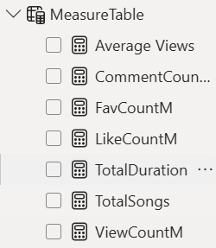

07
Created
Measures
1) Average Views : Avearge views calculated.
2) COMMENT COUNT : SUM OF COMMENTS CALCULATED.
3) Favourite count : sum of Favorite count calculated.
4) Like count : sum of like count calculated.
5) Total Duration : Total duration of song is calculated.
6) View Count : Sum of View count is calculated.

Slide 9

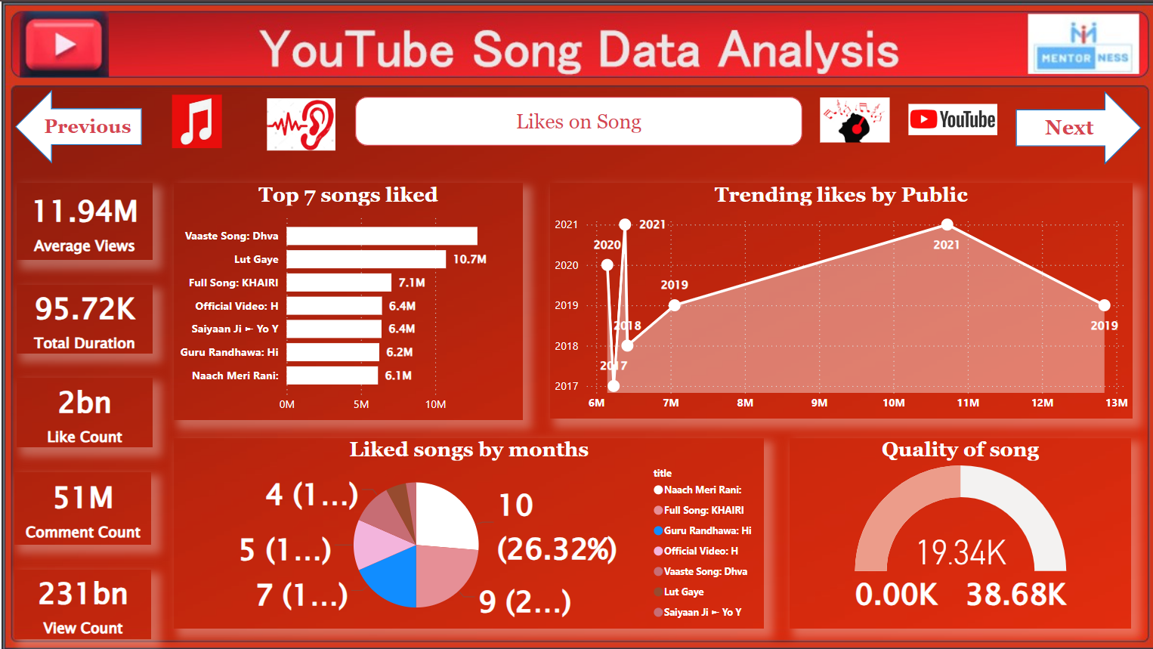
08
Power BI Dashborad
Song Data Analysis
ushashripati41997@gmail.com

Slide 10
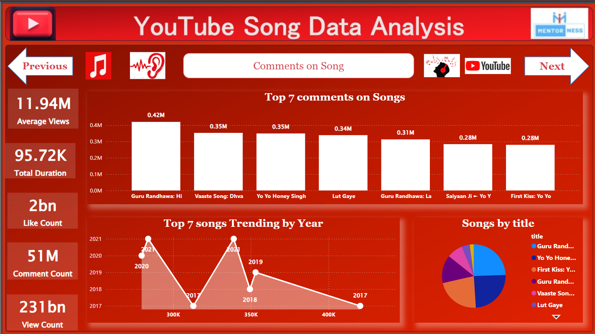
09
Power BI Dashborad
Song Data Analysis
ushashripati41997@gmail.com

Slide 11
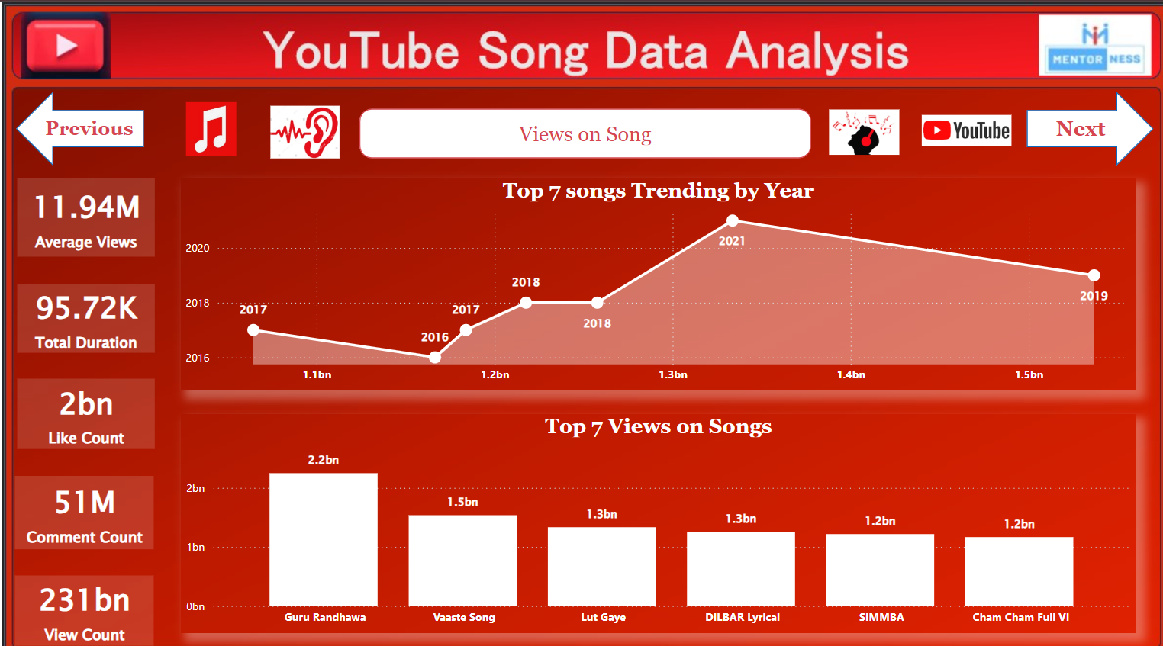
10
Power BI Dashborad
Song Data Analysis
ushashripati41997@gmail.com

Slide 12
11
Songs Data Visuals
Conculsion
Top 7 songs are most liked by public - the song are as follow - Vaaste Song, Lut Gaya, Khairi, Saayan Ji, Guru Randhawa, Nach Meri Rani all these songs tends to treand and listened more and liked by public because of Genre: Synthwave, Pop. Themes: Heartbreak, longing, and reconciliation. Musical Elements: 80s synths, upbeat tempo, catchy melody. This analysis showcases a well-rounded musical taste that values emotional depth, varied genres, and strong melodies.
These song - Vaaste Song, Lut Gaya, Khairi, Saayan Ji, Guru Randhawa, Nach Meri Rani are mostly trended in year 2021.
Top 7 songs are most commented by public - The songs Guru Randhawa has the most popular commented song around 4.2 Million public commented the song. Vaaste Song, Yo yo honey singh, Lut Gaya, Saayan Ji, Guru Randhawa, First Kiss all these are commented by public around 2.8 - 3.4 million people.
These songs were mostly commented by people in the lockdown period in the year 2020 - 2021.
Top 7 songs are most viewed by public - The songs Guru Randhawa has the most popular commented song around 2.2 Billion public viewed the song. Vaaste Song, Guru Randhawa, Lut Gaya, DILBAAR Lyrics, Cham Cham, SIMMBA are the trending songs have been viewed by public.
These songs were mostly just viewed by people in the lockdown period in the year 2019 - 2020.
ushashripati41997@gmail.com

Slide 13



12
Contact
Us
Website Portfolio -
https://sites.google.com/view/ushashree
Email -
ushashripati41997@gmail.com
Phone Number -
8329317365
LinkedIN -
https://www.linkedin.com/in/ushashreeshripati/
Github -
https://github.com/Ushashree441997tab=repositories

Slide 14


13
Power BI Published
Website Link
Please click on the below link to watch LIVE DASHBOARD
https://app.powerbi.com/view?r=eyJrIjoiZjU0ZjIxNmEtMTkxNS00MzZmLThlMjAtMzlkZWZlZDVkNDQwIiwidCI6IjQ5NmE3ZmFlLTM0ZmUtNDJmNS1iNjYzLTc3MjFlNmZhYzA0MCJ9
USHASHRIPATI41997@GMAIL.COM

Slide 15



14
THANK
YOU!
Thank you for your attention. For more information, please contact us at
ushashripati41997@gmail.com
8329317365

